Slide 1
CSE 15 Discrete Mathematics
Lecture 12 – Algorithms &
Growth of Functions

Slide 2
Announcement
HW #5 out
Due 5pm 10/19 (Fri) with 1 extra day of re-submission.
Write NEATLY!!!
Reading assignment
Ch. 4.1 – 4.3 of textbook

Slide 3
Greedy Algorithms
Optimization problems minimize or maximize some parameter over all possible inputs.
Optimization problems we will study are:
Finding a route between multiple cities with the smallest total mileage.
Determining how to encode messages using the fewest possible bits.
Optimization problems can often be solved using a greedy algorithm, which makes the “best” choice at each step. Making the “best choice” at each step does not necessarily produce an optimal solution to the overall problem, but in many instances, it does.
After specifying what the “best choice” at each step is, we try to prove that this approach always produces an optimal solution, or find a counterexample to show that it does not.
The greedy approach is an example of an algorithmic paradigm, which is a general approach for designing an algorithm. We will return to algorithmic paradigms in Section 3.3.

Slide 4
Greedy Algorithms: Making Change
Example: Design a greedy algorithm for making change (in U.S. money) of n cents with the following coins: quarters (25 cents), dimes (10 cents), nickels (5 cents), and pennies (1 cent), using the least total number of coins.
Idea: At each step choose the coin with the largest possible value that does not exceed the amount of change left.
If n = 67 cents, first choose a quarter leaving 67−25 = 42 cents. Then choose another quarter leaving 42 −25 = 17 cents.
Then choose 1 dime, leaving 17 − 10 = 7 cents.
Choose 1 nickel, leaving 7 – 5 = 2 cents.
Choose a penny, leaving one cent. Choose another penny leaving 0 cents.

Slide 5
Greedy Change-Making Algorithm
Solution: Greedy change-making algorithm for n cents. The algorithm works with any coin denominations c₁, c₂, …,c_{r} .
For the example of U.S. currency, we may have quarters, dimes, nickels and pennies, with c₁ = 25, c₂ = 10, c₃ = 5, and c₄ = 1.
Is it optimal for U.S. currency? (optimal=results in fewest coins)
Is it optimal for all denominations?
procedure change(c₁, c₂, …, c_{r}: values of coins, where c₁> c₂> … > c_{r} ; n: a positive integer)
for i := 1 to r
d_{i} := 0 [d_{i} counts the coins of denomination c_{i}]
while n ≥ c_{i}
d_{i} := d_{i} + 1 [add a coin of denomination c_{i}]
n = n - c_{i}
[d_{i} counts the coins c_{i}]

Slide 6
Proving Optimality for U.S. Coins
Show that the change making algorithm for U.S. coins is optimal.
Lemma 1: If n is a positive integer, then n cents in change using quarters, dimes, nickels, and pennies, using the fewest coins possible has at most 2 dimes, 1 nickel, 4 pennies, and cannot have 2 dimes and a nickel. The total amount of change in dimes, nickels, and pennies must not exceed 24 cents.
Proof: By contradiction
If we had 3 dimes, we could replace them with a quarter and a nickel.
If we had 2 nickels, we could replace them with 1 dime.
If we had 5 pennies, we could replace them with a nickel.
If we had 2 dimes and 1 nickel, we could replace them with a quarter.
The allowable combinations have a maximum value of 24 cents; 2 dimes and 4 pennies.

Slide 7
Proving Optimality for U.S. Coins
Theorem: The greedy change-making algorithm for U.S. coins produces change using the fewest coins possible.
Proof: By contradiction.
Assume there is a positive integer n such that change can be made for n cents using quarters, dimes, nickels, and pennies, with a fewer total number of coins than given by the algorithm.
Then, q̍ ≤ q where q̍ is the number of quarters used in this optimal way and q is the number of quarters in the greedy algorithm’s solution. But this is not possible by Lemma 1, since the value of the coins other than quarters cannot be greater than 24 cents.
Similarly, by Lemma 1, the two algorithms must have the same number of dimes, nickels, and pennies.

Slide 8
Greedy Scheduling
Example: We have a group of proposed talks with start and end times. Construct a greedy algorithm to schedule as many as possible in a lecture hall, under the following assumptions:
When a talk starts, it continues till the end.
No two talks can occur at the same time.
A talk can begin at the same time that another ends.
Once we have selected some of the talks, we cannot add a talk which is incompatible with those already selected because it overlaps at least one of these previously selected talks.
How should we make the “best choice” at each step of the algorithm? That is, which talk do we pick ?
The talk that starts earliest among those compatible with already chosen talks?
The talk that is shortest among those already compatible?
The talk that ends earliest among those compatible with already chosen talks?

Slide 9
Greedy Scheduling
Picking the shortest talk doesn’t work.
Can you find a counterexample here?
But picking the one that ends soonest does work. The algorithm is specified on the next page.
Start: 8:00 AM
Talk 1
Start: 9:00 AM
Talk 2
Start: 9:45 AM
End :9:45 AM
End: 10:00 AM
Talk 3
End: 11:00 AM

Slide 10
Greedy Scheduling algorithm
Solution: At each step, choose the talks with the earliest ending time among the talks compatible with those selected.
Will be proven correct by induction in Chapter 5.
procedure schedule(s₁ ≤ s₂ ≤ … ≤ s_{n} : start times, e₁, e₂ ,…, e_{n} : end times)
sort talks by finish time and reorder so that e₁ ≤ e₂ ≤ … ≤ e_{n}
S := ∅
for j := 1 to n
if talk j is compatible with S then
S := S ∪ {talk j}
return S [ S is the set of talks scheduled]

Slide 11
Unsolvable Problems
Unsolvable problems: problems that cannot be solved using any procedure/algorithm.
Example: the halting problem.
The halting problem is of the most famous theorems in computer science.

Slide 12
The Halting Problem
It asks whether there is a procedure that does this:
It takes as input a computer program and input to the program, and
determines whether the program will eventually stop when run with the input.
This would be useful to test certain things such as whether a program will enter into an infinite loop.

Slide 13
The Halting Problem
First note that we cannot simply run a program and observe what it does to determine whether it terminates when run with the given input.
If the program halts, we have our answer.
But if it is still running after any fixed length of time has elapsed, we do not know whether it will never halt or we just did not wait long enough for it to terminate.

Slide 14
The Growth of Functions (Ch. 3.2)
Big-O Notation
Big-O Estimates for Important Functions
Big-Omega and Big-Theta Notation

Slide 15
The Growth of Functions
In both computer science and in mathematics, there are many times when we care about how fast a function grows.
In computer science, we want to understand how quickly an algorithm can solve a problem as the size of the input grows.
We can compare the efficiency of two different algorithms for solving the same problem.
We can also determine whether it is practical to use a particular algorithm as the input grows.
Two of the areas of mathematics where questions about the growth of functions are studied are:
number theory (covered in Chapter 4)
combinatorics (covered in Chapters 6 and 8)

Slide 16
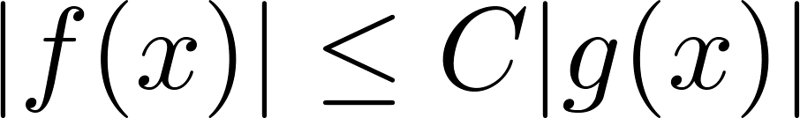
Big-O Notation
Definition: Let f and g be functions from the set of integers or the set of real numbers to the set of real numbers. We say that f(x) is O(g(x)) if there are constants C and k such that
whenever x > k. (illustration on next slide)
This is read as “f(x) is big-O of g(x)” or “g asymptotically dominates f.”
The constants C and k are called witnesses to the relationship f(x) is O(g(x)). Only one pair of witnesses is needed.

Slide 17
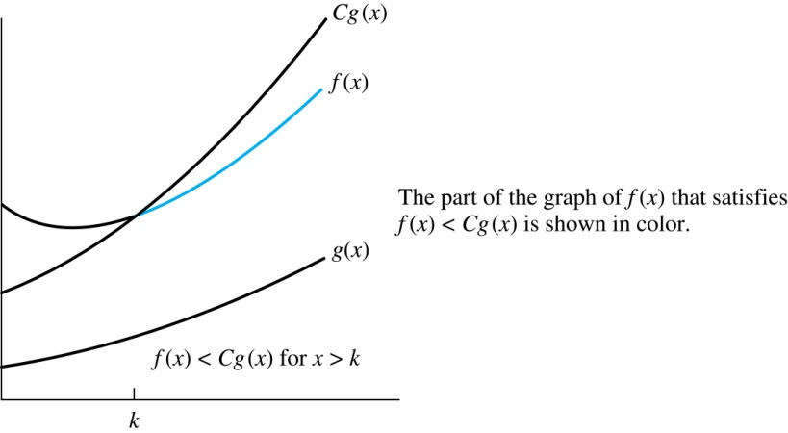
Illustration of Big-O Notation
f(x) is O(g(x))

